Slide 1

Designing User Experience
A guide to HCI, UX and Interaction Design
Fourth Edition
Part II
Techniques for designing UX
Chapter 7
Understanding

Slide 2
Contents
7.1 Requirements
7.2 Participative design
7.3 Interviews
7.4 Questionnaires
7.5 Probes
7.6 Card sorting techniques
7.7 Working with groups
7.8 Fieldwork: observing activities in situ
7.9 Artefact collection and ‘desk work’
7.10 Data analysis

Slide 3
The process of understanding
Before creative design can start, it is essential that the designer develops a clear and thorough understanding of the people who will be involved with the product or system, the activities that are the focus of the design, the contexts in which those activities take place and the implications for the design of technologies: ‘PACT’.
From this understanding, designers generate the requirements for the system that is to be designed.
However, it is rarely possible to acquire a thorough understanding of requirements until some design work has been completed and evaluated.
Requirements work (understanding), the design process, representations of design (envisionment) and evaluation are tightly interwoven.

Slide 4
The focus of understanding
The focus of the understanding process is on what people do, or might want to do, how and why they want to do things and on any problems they are having with any system currently in use.
It is also about understanding how the domain of investigation fits in with other things that people are doing.
UX designers should aim to develop technologies that make aspects of everyday life more efficient and enjoyable.
In this talk, we present the main techniques for understanding people’s activities and encapsulating this for design.
UX designers need to do research, also called user research, in order to inform their understanding of the sphere of activity (the domain) that is the focus of investigation.
In software engineering or information systems projects, this is a formal step which is usually termed ‘requirements analysis’.

Slide 5
Requirements (1 of 4)
UX designers need to find out what their clients want from a particular product, service or system.
They will express these wants and desires as requirements.
A requirement is ‘something the product must do or a quality that the product must have’ (Robertson and Robertson, 2012).
Designers will study current activities and gather stories of use and soon will have generated a great deal of information about the current situation and about people’s goals and aspirations.
The task now is to turn this into requirements for a new product, system or service.
Sometimes this is straightforward but often it will need a creative leap (through a process called ideation).

Slide 6
Iteration is key
This is why the analysis–design–evaluation process is so iterative.
The effectiveness of the designer’s creative leap can only be judged when user and other designers review the requirements, something that is best done with the aid of scenarios and early designs or a prototype.
Just to further complicate matters, additional requirements will emerge as the design process continues.

Slide 7
Requirements (2 of 4)
There has always been much debate about which of the following terms should be used for the requirements activity:
Requirements gathering, which suggests requirements are lying around waiting to be picked up with little interaction between designer and stakeholders
Requirements generation, which suggests a more creative activity that tends to de-emphasize links to current practice
Requirements elicitation, which suggests some interaction between stakeholders and designers
Requirements engineering – often used in software engineering projects, usually a very formal approach.

Slide 8
Requirements and understanding
This is one of the reasons we have moved to the term ‘understanding’, as it encapsulates ideas of gathering and generation.
Many interaction design projects start from a ‘design brief’ which may be quite a vague description of something the clients want.
Often clients will require a requirements specification – a formal written document that contains the requirements.
Developers also need a clear requirements specification at some point in the development process so that they can cost the project and manage it successfully.
Requirements specifications increasingly include prototypes, screenshots and other media.
When written they should be expressed in clear, unambiguous language and worded so that it will be possible to test whether the requirement has been met in the final system.

Slide 9
Requirements templates
The use of a standard format, or template, for specifying requirements is useful, particularly in larger projects. The exact presentation of the information is not important but at a minimum it should include for each requirement the following:
A unique reference number, ideally also coding whether the requirement is functional or non-functional
A one-sentence summary
The source(s) of the requirement
The rationale for it.
As Robertson and Robertson (2012) suggest, there are additional elements which will greatly add to the value of the requirements specification. The most significant of these are as follows:
The criteria for measuring whether the requirement has been satisfied
A grade for the importance of the requirement, for example, on a scale of 1–5
Dependencies and conflicts with other requirements
Change history.

Slide 10
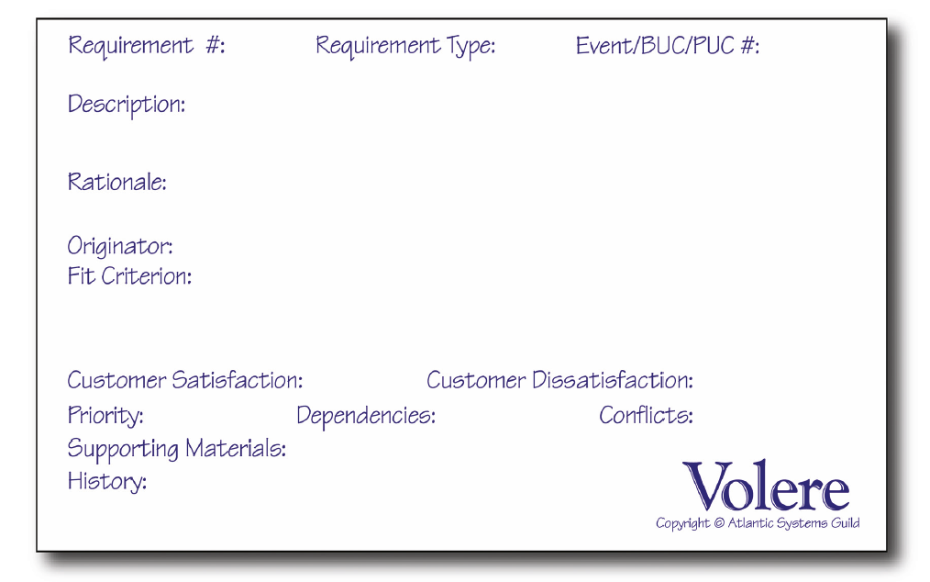
Volere specification
Notes:
Figure 7.1 An example of a Volere requirement specification

Slide 11
Requirements (3 of 4)
Conventionally, requirements are divided into two types, functional and non-functional.
Functional requirements are what the system must do.
Non-functional requirements are the qualities that the system must have.
These qualities may be crucial factors in the acceptability, sales or usage of a product.
Non-functional requirements cover a number of aspects of design, including image and aesthetics, usability, UX, performance, maintainability, security, cultural acceptability and legal restrictions.
Also important are the data, or media requirements of any system – the type of content that it has to deal with and the various media that will be used.

Slide 12
Requirements (4 of 4)
For both types of requirements, note that how the technology will meet the requirement is not specified.
This is a later part of the design activity.
It is best to supplement the list of requirements with some supporting evidence – interview or observation reports, photographs of artefacts and video snippets if practicable.
This helps readers of the requirements specification to understand the reason behind items in the list.

Slide 13
Prioritizing requirements
Requirements should be reviewed with customers and clients and modified as necessary. Decisions will almost always be made about the relative priority of the requirements since few design projects have unlimited resources. One way of doing this is by using the ‘MoSCoW rules’. These classify requirements into the following:
Must have – fundamental requirements without which the system will be unworkable and useless, effectively the minimum usable subset
Should have – would be essential if more time were available but the system will be useful and usable without them
Could have – of lesser importance, therefore can more easily be left out of the current development
Want to have but Won’t have this time round – can wait till a later development.
MoSCoW is an important part of agile development with the must have requirements determining the minimum viable product (MVP) that will be acceptable to a particular development.

Slide 14
Challenge 7.1
A Home Information Centre (HIC) is envisaged to be a new device for the home. Which of these requirements of the HIC are functional and which non-functional? Discuss issues of prioritizing the requirements:
Unobtrusive in the home environment
Option to print out details
Fast download of information
Direct ‘panic’ link to the emergency services
Volume control/mute features
Customizable to support choice of languages, including those with different character sets
Provides email
Security for each individual user.

Slide 15
Participative design
Research work involves using a variety of techniques to understand and analyse someone else’s needs, goals and aspirations.
The key thing for designers to remember is that they are not the people who will be using the final system.
Designers need to understand the requirements of other people.
This is not easy, but talking to people using interviews, observing people and recording their activities on video, organizing focus groups and having workshops will all help the designer to understand both the requirements for the new design (the ‘gain’ a new system or service will deliver) and the problems people are having with existing ways of doing things (the ‘pain’ of the current situation).

Slide 16
Engaging with people
By engaging with people using various techniques that encourage the participation of people in the design process, designers will acquire a large number of stories that form the basis for the analysis work.
Recasting several similar stories into more structured conceptual scenarios will also help the designer to understand and generate requirements.

Slide 17
Human-centred design
Throughout, we emphasize the need to take a human-centred approach to design.
First, it is important that human characteristics and activities are taken into account.
But beyond this, wherever possible, it is right that the people who will use new interactive technologies or services have an input to the design process itself.
We include the qualification ‘wherever possible’ not because we think that it is ever proper to exclude the interests of the widest range of stakeholders from the design process but because in design projects it is feasible to involve only a tiny proportion of those who will use the eventual system.
The situation is very different from the development of custom-made systems or services for a small group of people, where it is genuinely feasible for the people concerned to act as co-designers and so acquire ownership of the technology to be introduced.

Slide 18
The socio-technical tradition
This design philosophy of involving people in the design of their systems is usually attributed to the Scandinavian tradition of worker participation in the management of the workplace.
There are also links to the British socio-technical design movement and to the social informatics movement in the United States of America (Davenport, 2008).
This started with an emphasis on human considerations in the design of systems to support manual work, such as coal mining, but later evolved methods for user involvement in the design of computer-based systems.
The work of Enid Mumford at Manchester, and Ken Eason, Leela Damodoran, Susan Harker and their colleagues at Loughborough University and elsewhere, is central to this development of the socio-technical approach.
Methods embodying the socio-technical philosophy included Mumford’s ETHICS (Mumford, 1983, 1993), the HUFIT toolkit (Taylor, 1990), which provided a comprehensive, practical set of techniques for working with users, and ORDIT (Eason et al., 1996), which aimed to incorporate organizational considerations into systems design.

Slide 19
Scandinavian participatory design
The Scandinavian participatory design movement of the early 1980s was also important.
This was very much a politically informed initiative, with the emphasis on workplace democracy and empowering workers as co-designers of work practice and the tools supporting it.
Techniques such as paper prototyping were invented so that workers were not disadvantaged in working with technologists.
The most influential of such initiatives was the work of Pelle Ehn and colleagues in the UTOPIA project (Bødker et al., 1987; Ehn and Kyng, 1987).
More recently, Pekkola et al. (2006) have reviewed these earlier approaches and suggested how the demands of information systems development and participative design can be brought together.
Their method uses an iterative approach to design, bringing in participative methods and prototyping in order to ensure stakeholder involvement throughout the process.
Stakeholders were able to evaluate prototypes as a normal part of their work.
Deborah Mayhew’s Usability Engineering is another well documented and structured human-centred approach (Mayhew, 2008) as is the rapid contextual design of Karen Holtzblatt (Holtzblatt and Beyer, 2014).

Slide 20
Challenge 7.2
Incorporating input from those who will be affected by a changed system into the requirements process helps ensure that the eventual technologies have a good fit with the people, activities and contexts they are designed to support. There is also a strong ethical argument for user involvement. Can you think of another reason for doing this?

Slide 21
Acting out requirements
Alan Newell and his colleagues (e.g. Newell et al., 2007) have developed methods for acting out requirements in order to make them more understandable to the groups of people they are designing for – primarily older people.
The technique requires the designers to work with a professional script writer to develop a short stage play based on the requirements that have been generated.
This is acted out by trained actors with the stakeholders making up the audience.
Following the play, a trained facilitator leads an audience discussion on the play and the issues that it raised.
These discussions feed back into the understanding process, helping provide a rich understanding of the hopes, fears and concerns of the people.

Slide 22
Interviews
One of the most effective ways of finding out what people want and what problems they have at the moment is to talk to them!
Interviews with all the various stakeholders in the domain are a vital way of gathering stories.
Designers employ a range of different styles of interview from a completely structured survey through to a general conversation.
The structured interview uses questions that are developed beforehand.
The interview follows the wording exactly.
Public opinion polls, for example of the sort produced in great numbers before elections, are normally based on structured interviews.
Structured interviews are reasonably easy to carry out simply because of the degree of pre-structuring.
However, people are limited to very restricted replies, and it is difficult for the interviewer to follow up the unexpected response.

Slide 23
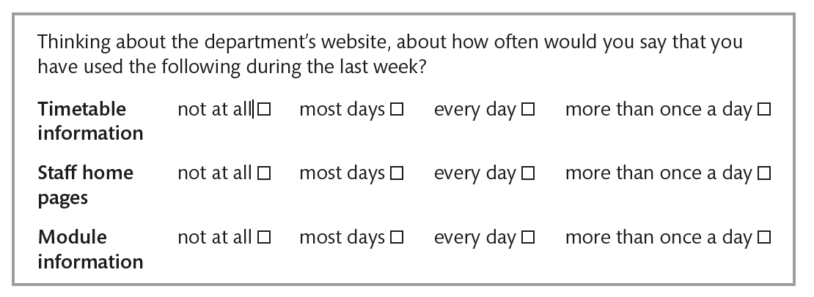
Here is an extract from a structured interview pro forma

Slide 24
Semi-structured interviews (1 of 2)
Designers very frequently use semi-structured interviews.
Sometimes, the interviewer is armed with pre-prepared questions but can reword these as appropriate and explore new topics as they arise.
Often, the interviewer simply prepares a checklist, sometimes with suitable prompts such as ‘Tell me about the first things you do when you get into the office in the morning’.
Clearly, this free-form approach is more demanding for the interviewer, but the data obtained does generally repay the effort.

Slide 25
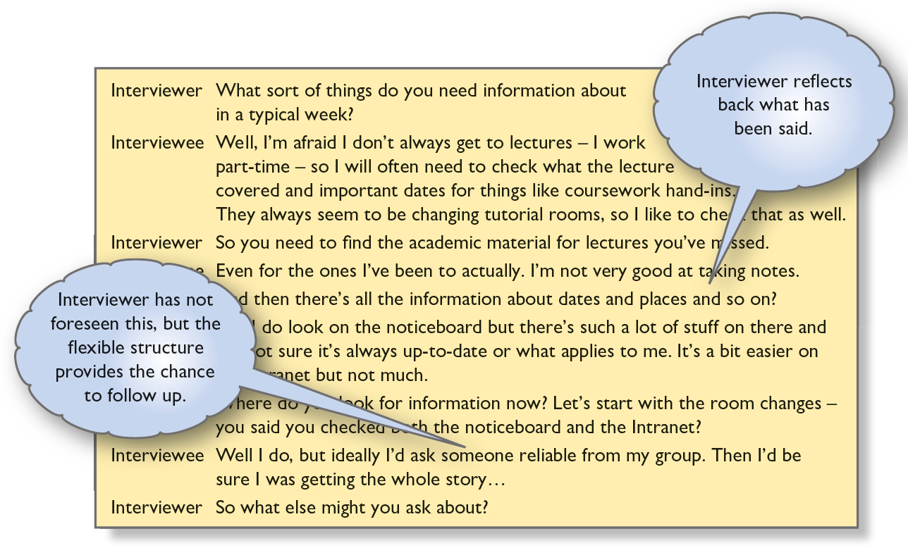
Semi-structured interviews (2 of 2)
An example of such an interview is shown in Figure 7.3 with some annotations about interviewing technique.
The interview is designed to start at a high level then to probe at a greater level of detail.
The analyst’s checklist of topics to cover for this example included the type of information needed, current sources (paper or on-line) and specific examples of information needs.
Completely unstructured interviews are sometimes used where it is particularly important to minimize designers’ preconceptions, or where very little background information is available beforehand.
As the term suggests, there are no preset questions or topics beyond the general subject of the project in question.
Notes:
Figure 7.3 Extract from a semi-structured interview

Slide 26
Contextual inquiry (1 of 2)
Contextual inquiry (CI) is a first-stage design method by Holtzblatt and Beyer (Beyer and Holtzblatt, 1998; Holtzblatt, 2012). They observe the following:
‘The core premise of CI is very simple: go where the customer works, observe the customer as he or she works and talk to the customer about the work. Do that and you can’t help but gain a better understanding of your customer’.
CI brings together a number of techniques including artefact collection and observation under one unifying theme or philosophy.

Slide 27
Four guiding principles of contextual inquiry (1 of 2)
Context. Here the advice is to go to the customer’s workplace and observe how work is actually carried out.
This allows the designer to experience the rich everyday detail of work. It is best to focus on concrete data and tasks (i.e. user stories) rather than generalized abstraction.
Partnership. One of the core premises of CI – and of its Scandinavian ancestors – is that analysts and designers and customers are expert in their different fields.
The designer should be looking for patterns and structure in the work while the customer contributes her knowledge of how the work really gets done.
As redesign ideas occur, they can also be discussed.
Thus customers can genuinely influence the designer’s interpretations of the work and design ideas based upon it.
The relationship is characterized by Beyer and Holtzblatt as the ‘master–apprentice model’.

Slide 28
Four guiding principles of contextual inquiry (2 of 2)
Interpretation. It is not enough simply to observe and document: the designer must interpret workplace data so that it is properly understood.
The designer abstracts from the stories, producing a more conceptual interpretation and should reflect his/her interpretations back to the customer and listen to the response.
Be prepared to be wrong.
Focus. Each site visit and interview needs a focus, though concentrating on one part of the work helps see detail but at the expense of other aspects.
Be clear about the focus and try to make neither too broad nor too narrow.

Slide 29
Contextual inquiry (2 of 2)
The aim of contextual inquiry is for designers to get design data by immersing themselves in the lives of their users.
In-depth interviews are followed by an interpretation session typically involving 2–5 designers.
From this interpretation of the data, they generate notes each of which captures one key point from the interview and is self-contained.
These notes capture key practical issues, identity and cultural observations, activity issues, device usage, design ideas and so on.
These notes will be used later in the process of design when they generate activity diagrams.

Slide 30
Challenge 7.3
What sort of information is likely to be missed by interviews? Why?

Slide 31
Stories, scenarios and early prototyping in interviewing (1 of 2)
Scenarios and stories are helpful aids to understanding activities and help avoid having people imagine (or reconstruct) situations in the abstract.
For example, people can be asked to recall a typical ‘day in the life’ or incidents when the current technology does not support what they need to do.
This will identify circumstances that the new design must take into account.
Once there is a rough idea of what the new technology might do, discussing a scenario will highlight many issues, from the naming of individual functions to the impact of changes in work practice.
Prototypes – anything from paper sketches to semi-functioning products – are very often used to embody scenarios in possible technology.
For example, in the later stages of analysis for a shared notebook for engineers, we used simple prototypes created in PowerPoint coupled with small usage scenarios.
These were projected on a screen and discussed in a small group meeting, prompting discussion about the match between our design ideas and the way the engineers currently disseminated information.

Slide 32
Stories, scenarios and early prototyping in interviewing (2 of 2)
Whether or not a prototype is used, the analyst and the customer ‘walk through’ the scenario, while the analyst probes for comments, problems, possible alternatives and suggestions in general.
Depending on the outcome of the scenario/prototype walkthrough, modifications and further iterations may be desirable.
Where many new issues emerge, it may be the case that the early concepts underlying the scenario or prototype are misconceived and should be radically rethought.

Slide 33
Think-aloud commentaries
When it is necessary to know a good deal of low-level detail about current technology, users can be asked to talk through the operations concerned – including their internal cognitive processes (i.e. what they are thinking about) – as they use the technology in question.
This data, properly termed a ‘verbal protocol’ (Ericsson and Simon, 1985), can provide helpful indications of current problems.
It is important to remember, however, that by imposing the requirement to generate a commentary, you are interfering with the very process you are attempting to study.
Further, not all cognitive processes can be accessed by the conscious mind.

Slide 34
Preparation for interviewing
First of all, you will have to decide who to interview and what you hope to get from the interview that will contribute to your understanding.
You will need to determine that you can get access to the people you want to talk to.
Consider bringing along some stimuli for the interview to help people envision what you are trying to understand.
Prepare a research brief.
Get to know the background to the project and any organizations involved.
Be clear about what you want to find out and whether a structured, semi-structured or unstructured interview will be most effective.
Decide whether to interview people individually or in groups. (See Section 7.7 on working with groups.)
Get to know the context for the interview.
For work activities, background research might include studying company reports, brochures, websites and organization charts or scanning through software manuals and promotional materials.
For other activities, general research on the internet will help understand the characteristics of the domain and the activities that people are involved in.

Slide 35
Keeping track of the interview
Interviewing is hard work and more effective if carried out by a pair of interviewers.
One person can take the lead while the other makes notes.
Of course, the note-taking burden is relieved if the interview is audio- or video-recorded.
In this case, make sure you check the equipment before each session and periodically during the interview.
Even when the interview is recorded, notes are still useful and will help find key points.
Interviews can be transcribed and used as the basis of a grounded theory analysis (see Section 7.8).
However, this is a time-consuming form of analysis and often just watching a video or listening to the audio of an interview is sufficient.
Keep the interview on time.
Know what you want to understand and ensure that you cover all that you need to.

Slide 36
Structuring the interview
Many interviews (unless completely structured interviews such as surveys) will use a mixture of open and closed questions.
Begin with some general questions to help settle the interviewee down.
Beware of using too much jargon and ask your interviewee to explain any jargon or acronyms that they use.
Do not be afraid of appearing foolish.
If you have done your preparation, people should be willing to explain the detail to you.
Ask the interviewee to tell stories about their activities.
As listeners, designers are looking for any problems that people are currently experiencing (the pain) and scope for improvements or endorsements of early design ideas (the gain).
As storytellers, people will provide details that may seem irrelevant but will often contain valuable context that designers need to understand.
Make sure that you round off the interview by asking if you have missed anything important and close the session leaving the way open for further discussions and clarifications.

Slide 37
Reflection and exploration
Reflecting back during the interview helps confirm that you have understood what has been said.
It is often a good idea to have the interviewee review a summary of the interview that you can email after you have written it up.
You should also look over the notes of the interview yourself to identify any points that need clarification.

Slide 38
General-purpose exploratory questions
These help the interview along, especially in the early stages or with a taciturn interviewee. Some we have found useful are as follows:
‘Tell me about your typical day’.
‘Tell me three good things about . . .’
‘… and three bad things’.
‘What if you had three wishes to make the service better’ ?
‘What has gone wrong with the service recently? How did you cope’ ?
‘What else should we have asked about’ ?

Slide 39
When to stop
Deciding when you have conducted enough interviews means balancing practical constraints against the comprehensiveness of the data you need for your research.
Certainly, all significant stakeholder groups must be covered, two or three interviewees per type of stakeholder should be enough.
There may be a need to look at different types of organization or contexts of use.
In many cases, client resources limit the process.
With unlimited resources, the general rule is to stop once no new insights are being obtained.

Slide 40
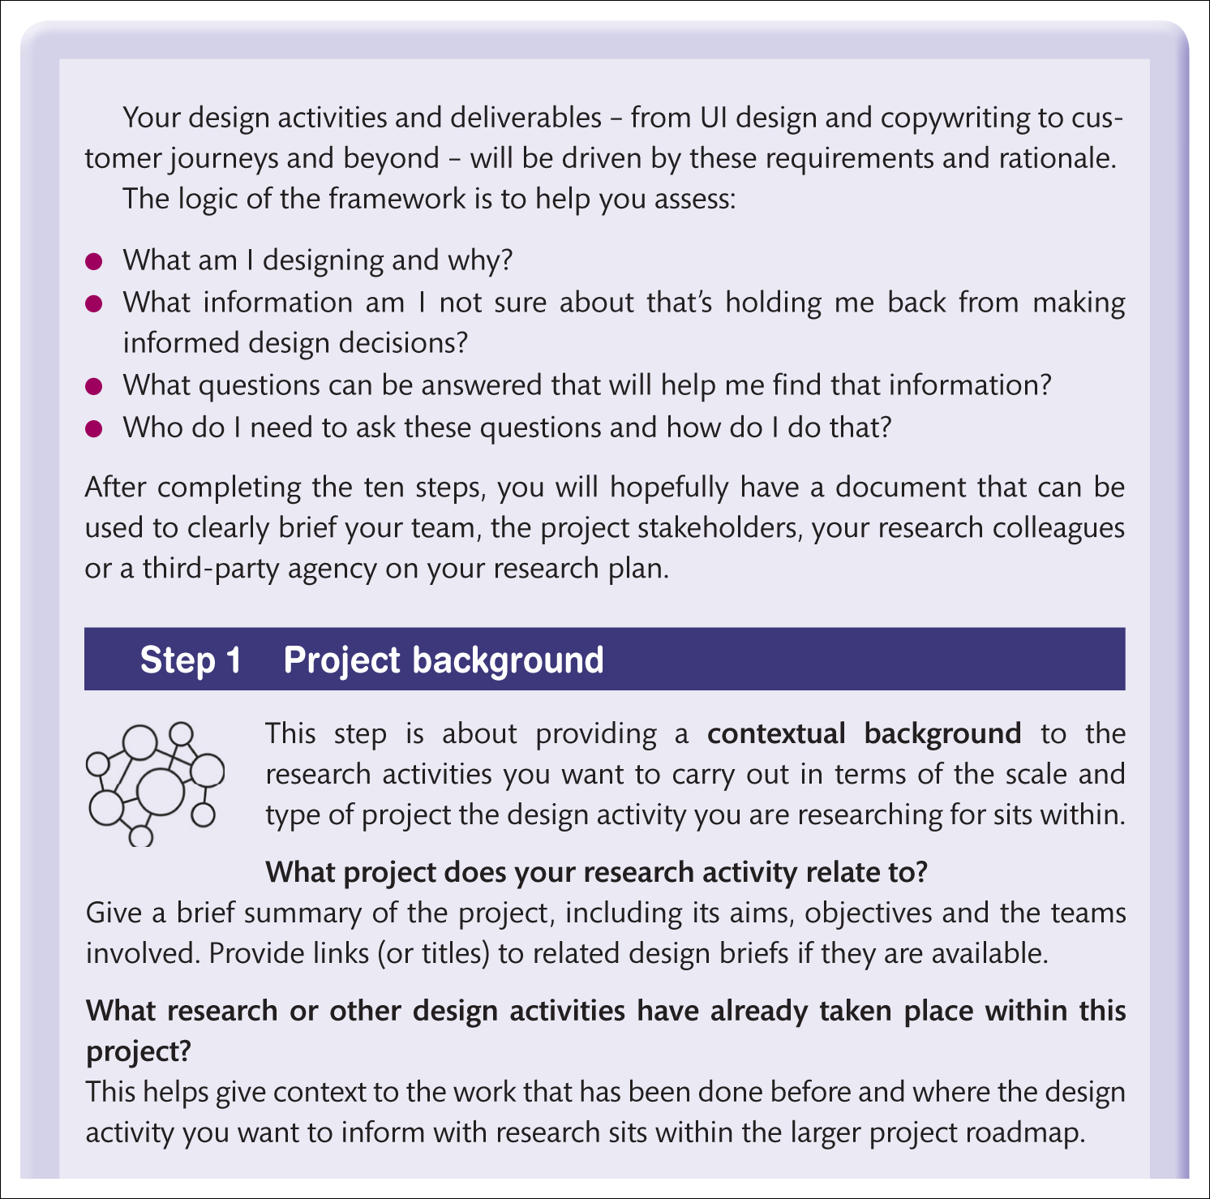
Oli Mival’s guide (1 of 4)

Slide 41
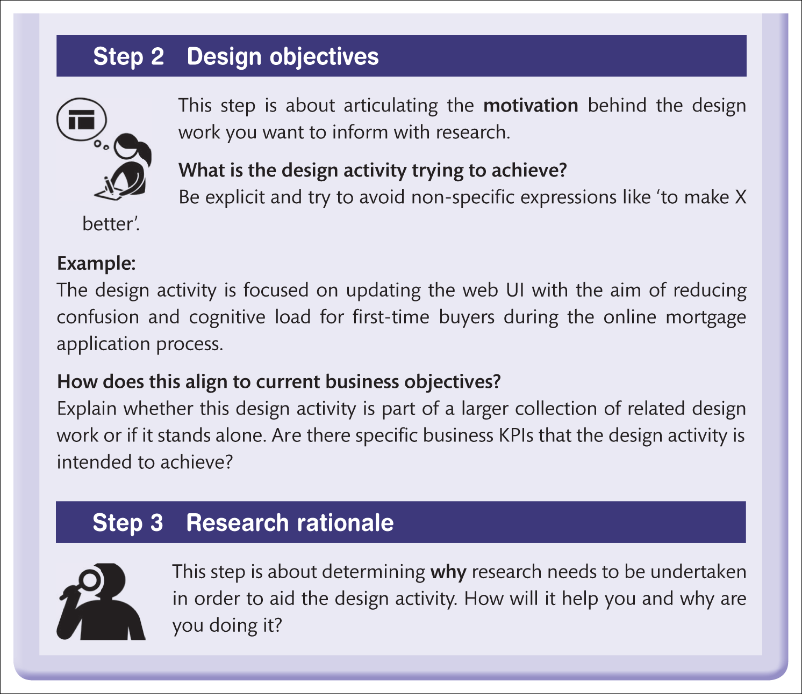
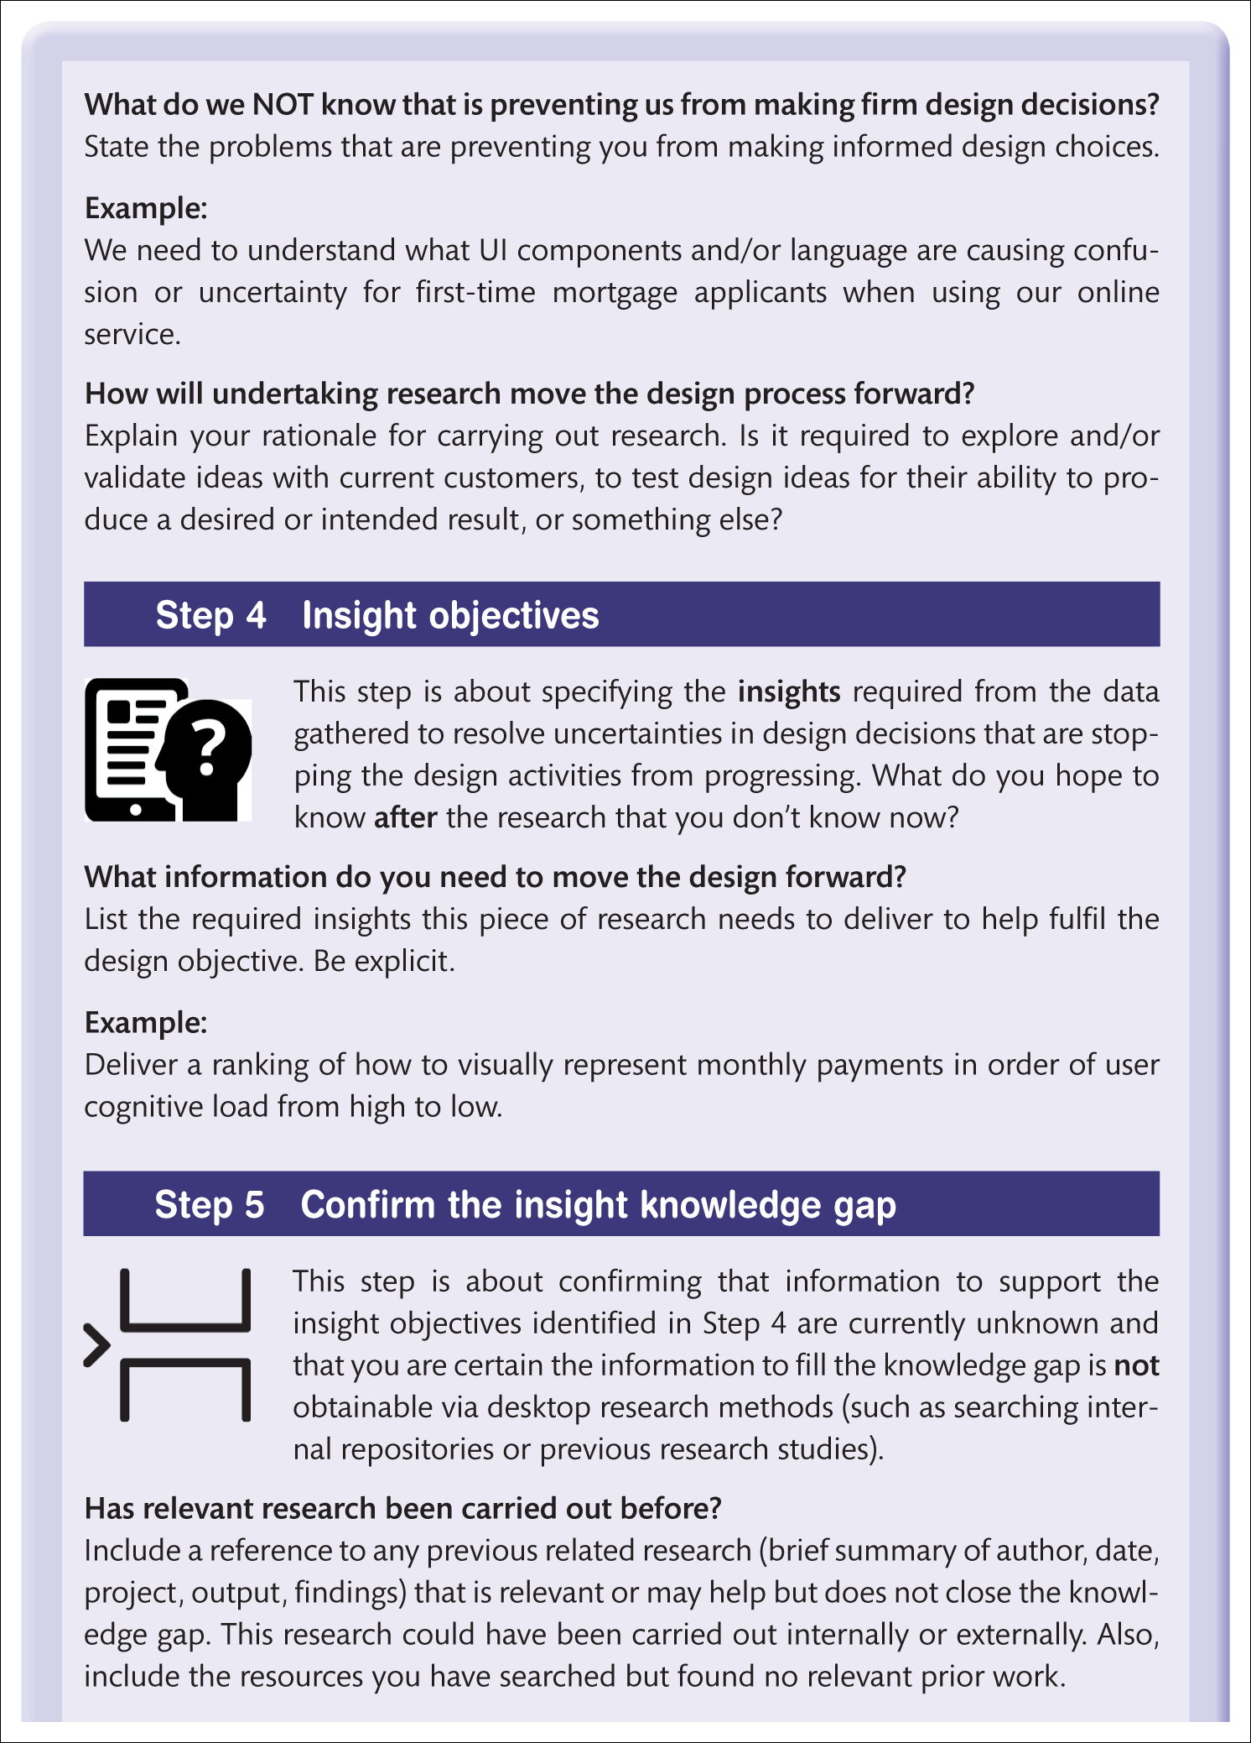
Oli Mival’s guide (2 of 4)

Slide 42
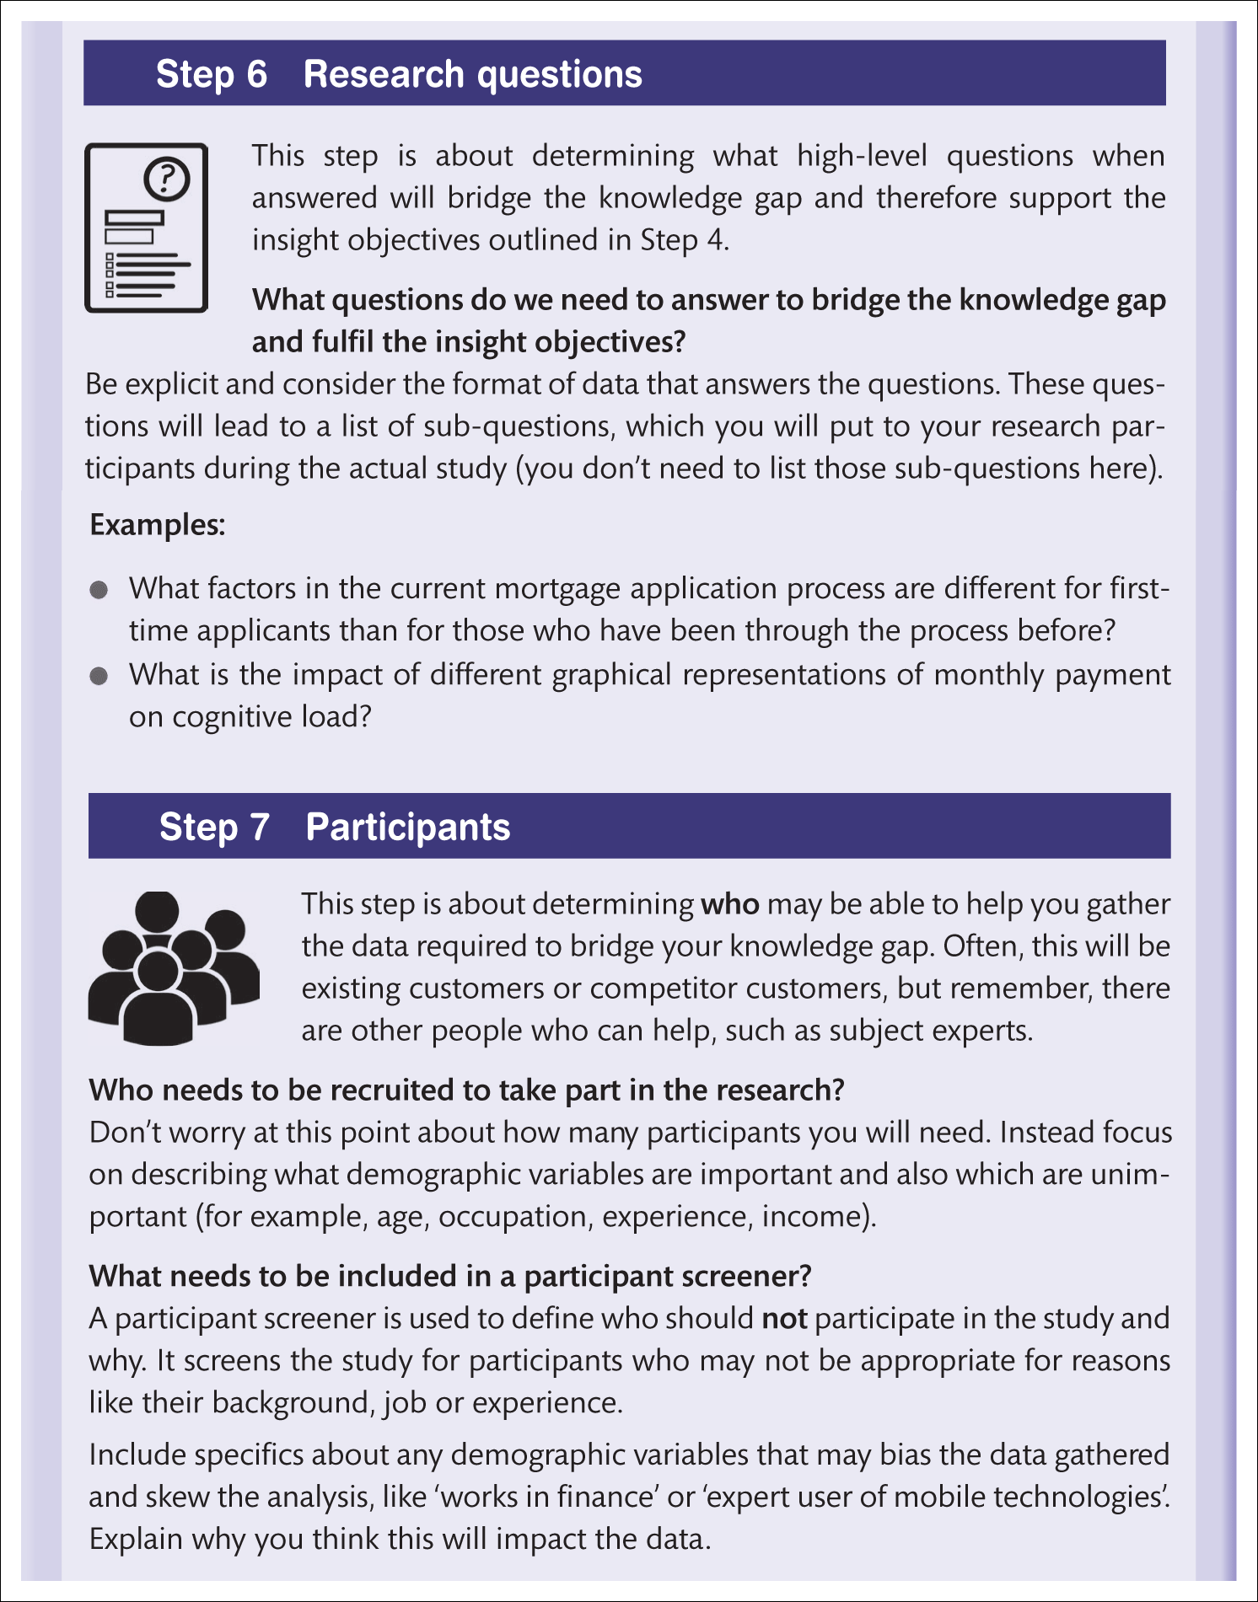
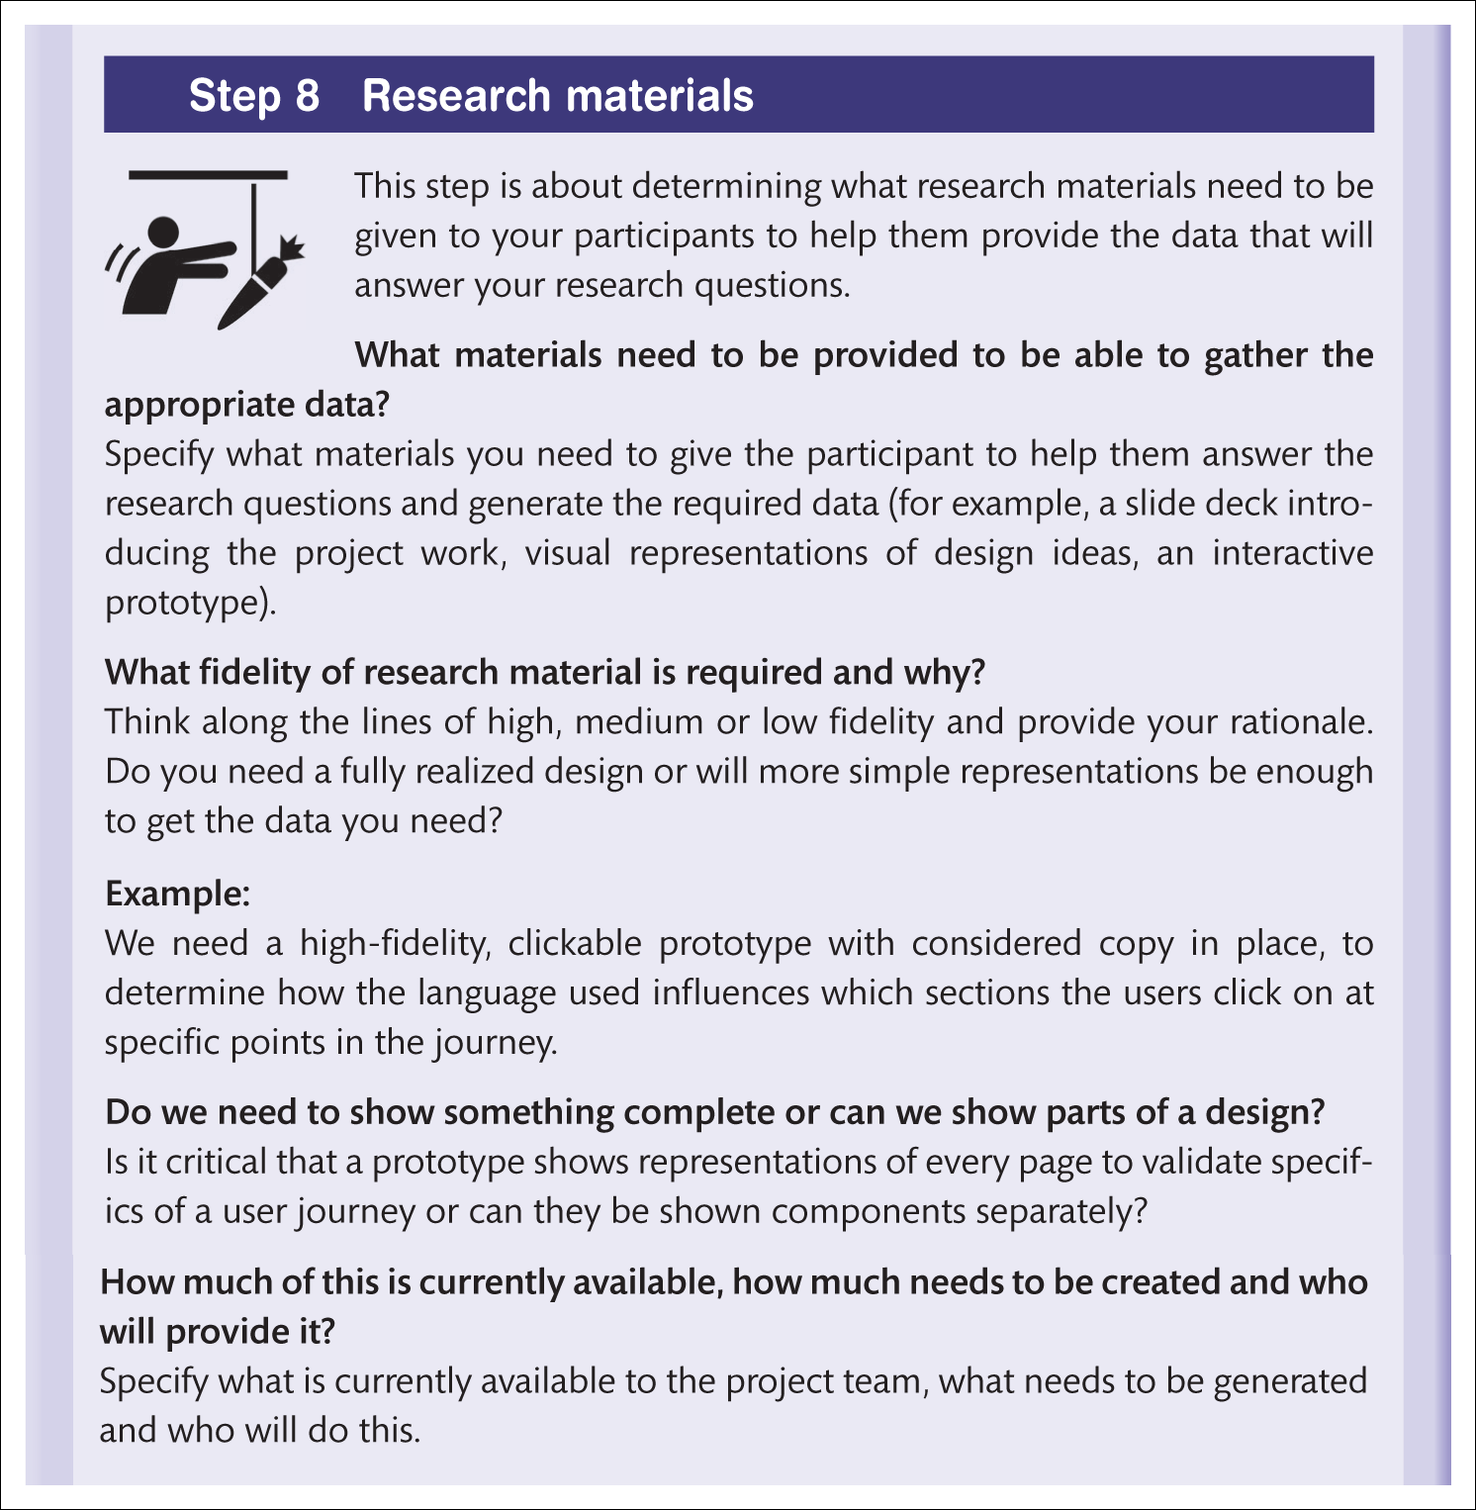
Oli Mival’s guide (3 of 4)

Slide 43
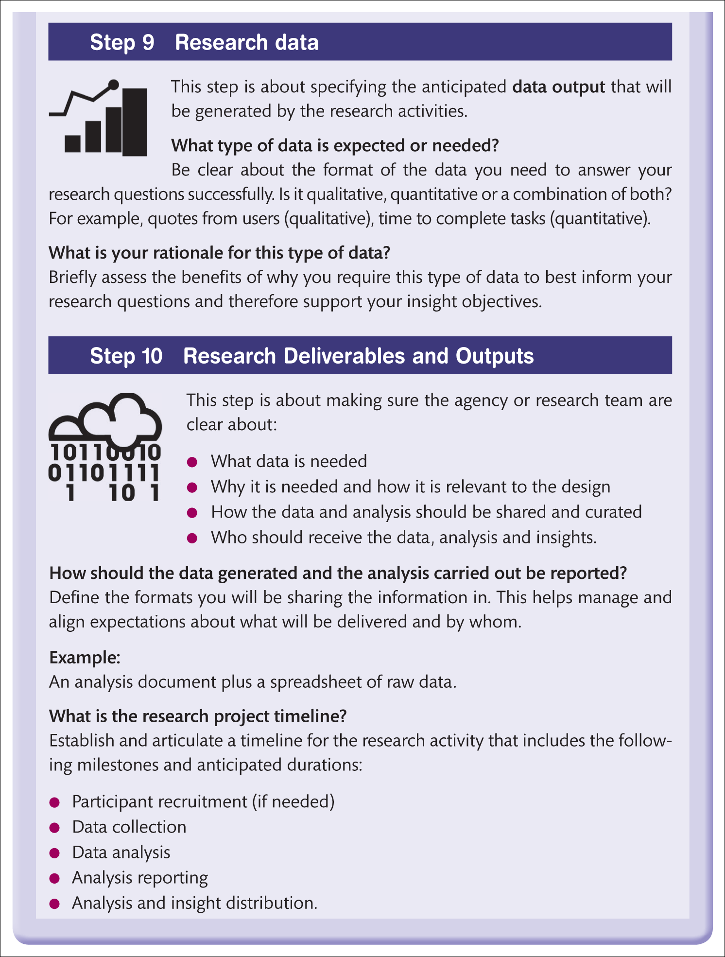
Oli Mival’s guide (4 of 4)

Slide 44
Questionnaires (1 of 4)
Most of the methods we discuss in this chapter involve working with people face-to-face.
However, there are ways of obtaining requirements information at a distance.
The most common of these is the questionnaire but there are more ingenious, novel techniques as well.

Slide 45
Questionnaires (2 of 4)
Questionnaires are one way of streamlining the understanding process if a large number of people are to be surveyed and resources are not available to interview them individually.
However, constructing a workable questionnaire is surprisingly difficult and time-consuming.
It is a skilled task to devise the wording of questions when there are no opportunities to detect and clear up misunderstandings as they happen.
Questionnaires need to be designed, prototyped and evaluated in the same way as any other form of interaction design.
For small numbers of people – up to 10 or so – an interview will obtain the same information, and more, in a manageable way.
This will consume little or no extra resource if the time required to construct a questionnaire is taken into account.

Slide 46
Questionnaires (3 of 4)
Questionnaires are ideally suited to gathering a large amount of quantifiable data or to capture responses from people who cannot be involved more directly.
With the proliferation of on-line questionnaire services such as Survey Monkey, quite complex questionnaires can be constructed and made available on the web.
Another technique for gathering data is ‘crowd sourcing’.
Here, small specific tasks are put on the web and volunteers sign up to take the tasks in return for a small payment.
Amazon’s ‘Mechanical Turk’ is the best-known example but needs careful design of the task if it is to be effective.

Slide 47
Questionnaires (4 of 4)
A good questionnaire is time-consuming to construct so that all the items:
Are understandable.
Are unambiguous.
Collect data which actually answers evaluation questions.
Can be analysed easily.
Response rates to questionnaires can be very low indeed – return rates of under 10 per cent are common if the intended respondents have no particular stake in the design of the technology or incentive (being entered into a prize draw, for example) to participate.
Where questionnaires are administered as part of a face-to-face evaluation session, most people will complete them but people who take them away to finish in their own time, or who do the questionnaire on the web, very often don’t.

Slide 48
Analysing the data
Analysing the data requires thought and time.
If most respondents have awarded feature ‘A’ 5 out of 7 for usefulness but feature ‘B’ 6 out of 7, does this really mean that feature B is better?
Or is it enough that both features score above the mid-point?
Maybe feature A was misunderstood – without a follow-up question the data is difficult to interpret.
This is easy to do in an interview but would add significantly to the length of a questionnaire.
Where respondents have been given the opportunity to express opinions as unstructured answers, you will need to devise a scheme for classifying this material so that it is usable.

Slide 49
Likert scales (1 of 2)
Perceptions of system design are often collected through rating scales, known as Likert scales (Likert, 1932).
The Likert scale is the most common of a number of methods for eliciting opinion. People are asked to indicate their agreement with a statement using a five-point scale: Strongly agree, Agree, Neutral, Disagree and Strongly disagree or a seven-point, four-point or ten-point scale. The scale is attached to each of a number of statements such as:
I always knew what I should do next (Tick one box):
Strongly agree 
Agree 
Neutral 
Disagree 
Strongly disagree 
Icons were easily understandable:
Strongly agree 
Agree 
Neutral 
Disagree 
Strongly disagree 
The destination of links was clear.
Strongly agree 
Agree 
Neutral 
Disagree 
Strongly disagree 

Slide 50
Likert scales (2 of 2)
Getting the wording right and choosing appropriate statements to elicit information relevant to the enquiry is surprisingly difficult and much trial and revision of statements will be required.
The items on a questionnaire should be as specific as possible.
A probe statement such as ‘The system was easy to use’ does provide a general impression but gives very little information for redesign if you do not supplement it.

Slide 51
Semantic differentials
Another approach is to devise ‘bipolar’ rating scales’, often called semantic differentials.
These derive from the work of Osgood (Osgood et al., 1957) and have evolved into a very powerful way of uncovering the feelings people have towards ideas, products, services and brands.
For example, Brian Lawson (2001) used semantic differential to find out what people liked about pubs and we have used similar methods to explore what people liked about places and how they were represented in a virtual environment (VE).
The ‘place probe’ (Benyon et al., 2006; Smyth et al., 2015) was designed to obtain people’s responses to a photo-realistic VE of different places.
Deriving from the work of Ted Relph and others about the sense of place (Relph, 1976), the probe contained semantic differentials about the quality of the images, the sense of freedom people had to move around and their overall visual perception and subjective feelings of the place.

Slide 52
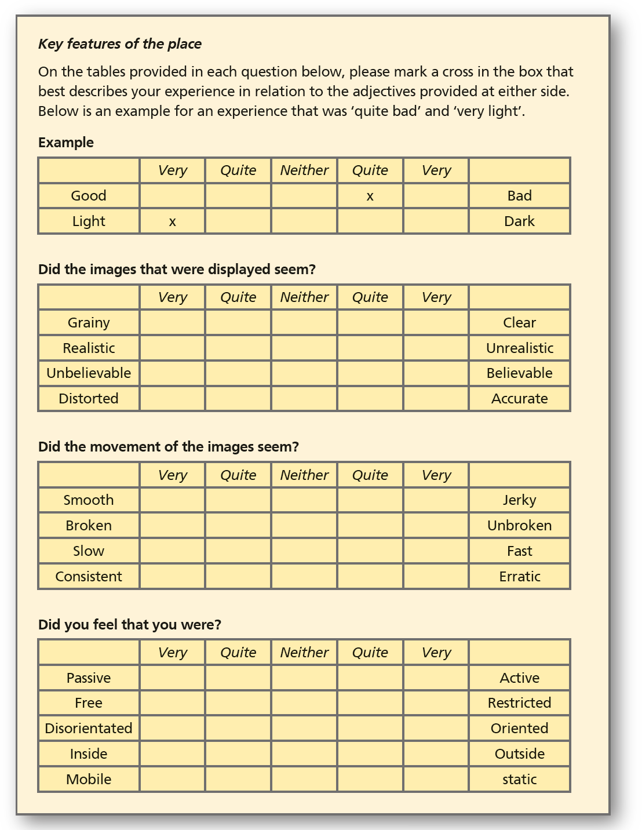
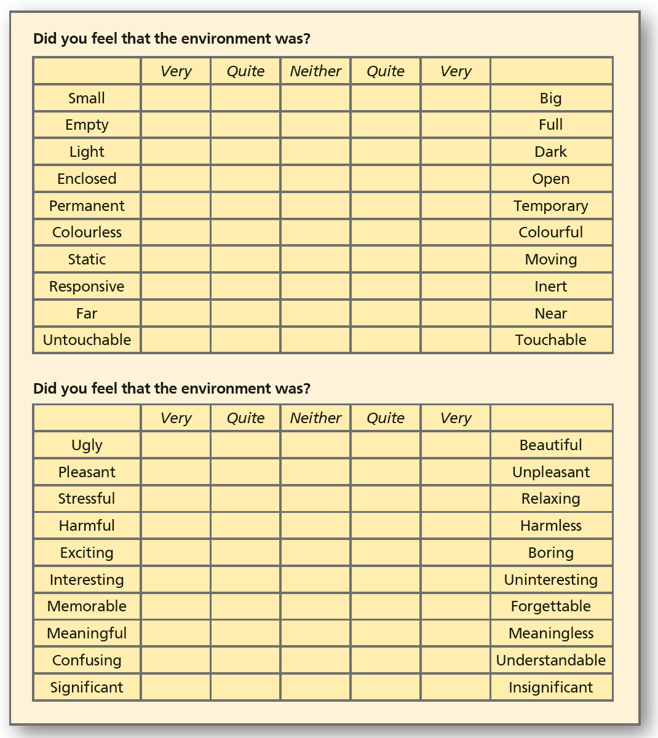
Figure 7.5 Semantic differential

Slide 53
Other opinions
To gather requirements and opinions about system features, several ready-made and validated usability questionnaires are available, for example, QUIS (Questionnaire for User Interface Satisfaction) from the University of Maryland and SUMI (Software Usability Measurement Inventory) from the University of Cork.
These are ‘industrial strength’ instruments and there is normally a fee for their use.
Others may be found in textbooks and on the web, but in the latter case, be sure that their source is a reliable one.
The user experience questionnaire uses semantic differentials to assess the quality of a product or service (http://www.ueq-online.org/).
The System Usability Score (SUS) is a short questionnaire to assess usability (see Chapter 5 and http://www.usability.gov/).

Slide 54
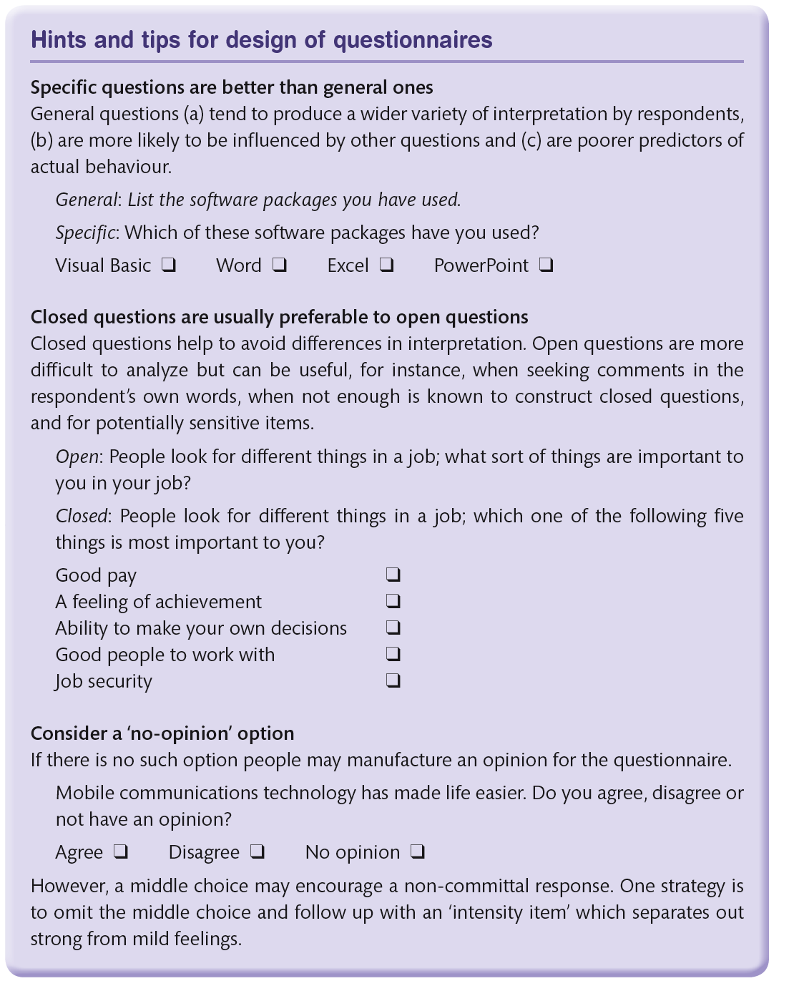
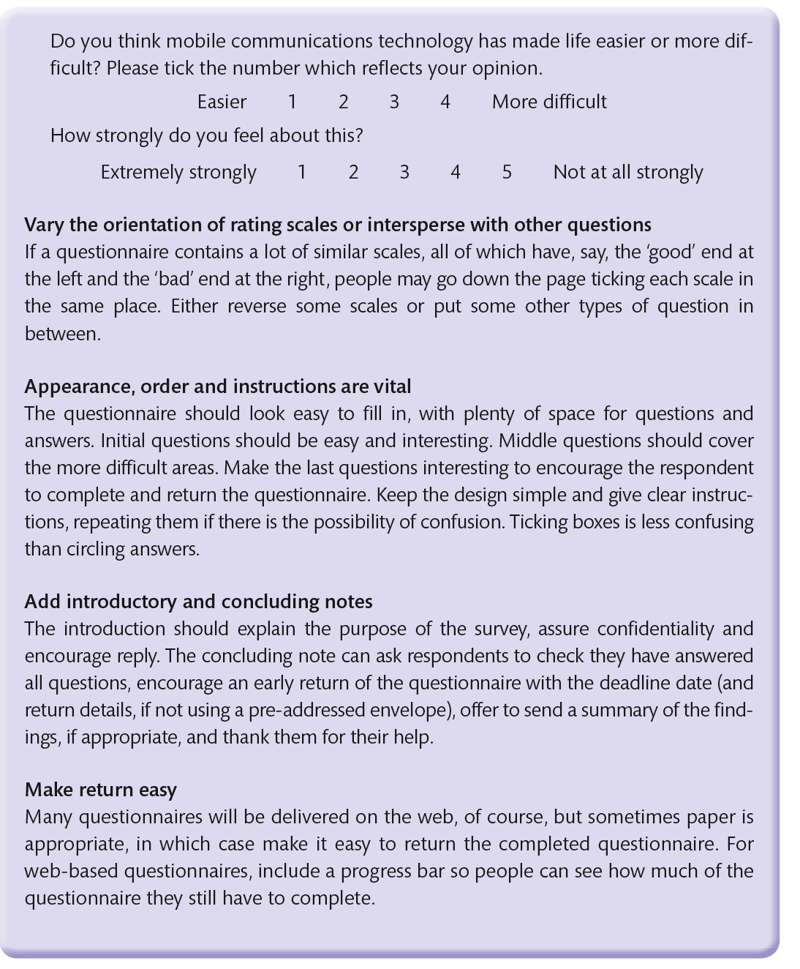
Box 7.3

Slide 55
Questionnaires conclusions
The ‘hints and tips’ should help you to produce more worthwhile questionnaires.
If the questionnaire is very lengthy, however, or targeted at a very large group, then we strongly recommend you consult a reference such as Oppenheim (2000) or an expert in questionnaire design.
Perhaps, the most important piece of advice is to pilot the questionnaire in draft form with a few people who are similar to the target group.
It is always surprising how an apparently simple question can be misunderstood.

Slide 56
Probes
Probes are collections of artefacts designed to elicit requirements, ideas or opinions in specific contexts.
‘Cultural probes’ were developed by Bill Gaver and colleagues (Gaver et al., 1999) in working with elderly people located in three European cities.
The overall aim was to design technologies that would foster greater participation in the community by older people.
The designers first got to know the groups in person, then introduced them to the cultural probes packages.
Each person received a collection of maps, postcards, a disposable camera and booklets – each item being carefully designed to stimulate interest and curiosity and suggesting ways in which people could use it to send ideas back to the designers.
They were ‘designed to provoke inspirational responses’ (ibid., p. 22).

Slide 57
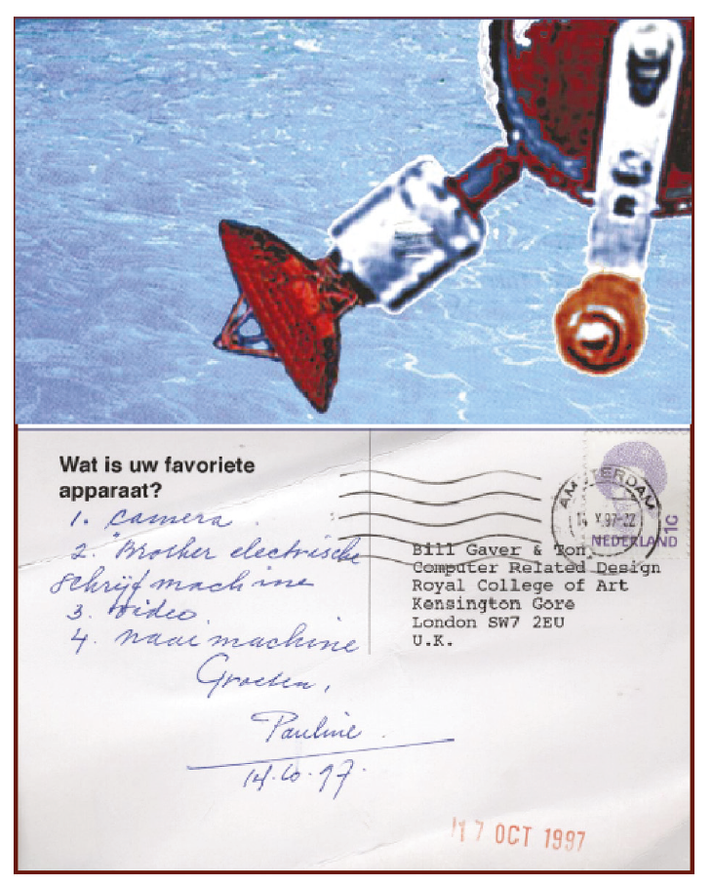
Cultural probes (1 of 2)
Postcards such as that shown in Figure 7.6, for example, asked people to list their favourite devices.
The disposable cameras had customized covers which suggested scenes to be captured, such as ‘the first person you will see today’ or ‘something boring’.
Over a period of weeks, many of the probe materials were sent back to the designers, carrying rich data about the lives of the elderly people.
Not all items worked out as planned – the authors do not specify which – and the materials were selectively redesigned before being distributed to subsequent participants.
Source: Gaver, W.W., Dunne, T. and Pacenti, E. (1999) Design: Cultural probes, Interactions, 6(1), pp. 21–29 © 1999 ACM, Inc. Reprinted by permission. http://doi.acm.org/10.1145/291224.291235
Notes:
Figure 7.6 Postcard used as a ‘cultural probe’

Slide 58
Cultural probes (2 of 2)
All in all, the exercise was highly successful in capturing the general sense of what it meant to be elderly in the communities involved, although it is noted that the results did not have a direct impact on design.
The philosophy behind cultural probes was rather different than trying to gather requirements and illustrates well the difference between requirements elicitation and requirements generation.
Gaver argues that probes are meant to confront, they are intended to provide inspiration for designers rather than elicit specific requirements.

Slide 59
Technology probes
Technology probes are another form of probe that were used to gather requirements for home technologies and the area has now evolved into a whole area of ‘probology’.
In discussing the use of mobile probes (Hulkko et al., 2004), it is argued that probes are humane, they create fragments of understanding and insight and use uncertainty through providing stories.
Probes inspire and provoke designers to engage with the lives of others.
Another analysis of probes (cultural, mobile, domestic and urban) by Graham et al. (2007) concludes that probes represent the ‘turn to the personal’ in a direct reference to the ‘turn to the social’ that happened in HCI at the beginning of the 1990s (see Chapter 18 for more on this).
Probes are an amalgam of social science methods for understanding (such as photography, diaries, life documents and so on) that enable designers to focus upon the individual’s everyday life, going beyond the general.

Slide 60
Probes concluded
People find it very difficult to express abstract ideas and probes are a way of provoking them to think about things in a different way.
They are one form of stimulus needed to help designers get the data they need (see Box 7.2).
As with other techniques for helping designers in the understanding process, probes will need thoughtful design, prototyping and evaluation before they are used in the real investigation.

Slide 61
Card sorting techniques (1 of 5)
Card sorting refers to a number of techniques concerned with understanding how people classify and categorize things.
It has been said that trying to find things on a website is like looking for the scissors in someone else’s kitchen.
You know there are some but finding them can be another matter altogether.
How people organize things is a very personal matter.
Card sorting is particularly relevant in information architecture design as the structure of the content is critical.

Slide 62
Card sorting techniques (2 of 5)
As a method of understanding, card sorting can be used in a number of ways.
At its most basic, card sorting involves writing concepts onto cards and then grouping them in different ways.
A group of people work with a facilitator to structure data, concepts, objects or other artefacts, trying to understand what categories are most appropriate to group them together.
This results in a taxonomy (a classification) and a set of high-level concepts known as an ontology.

Slide 63
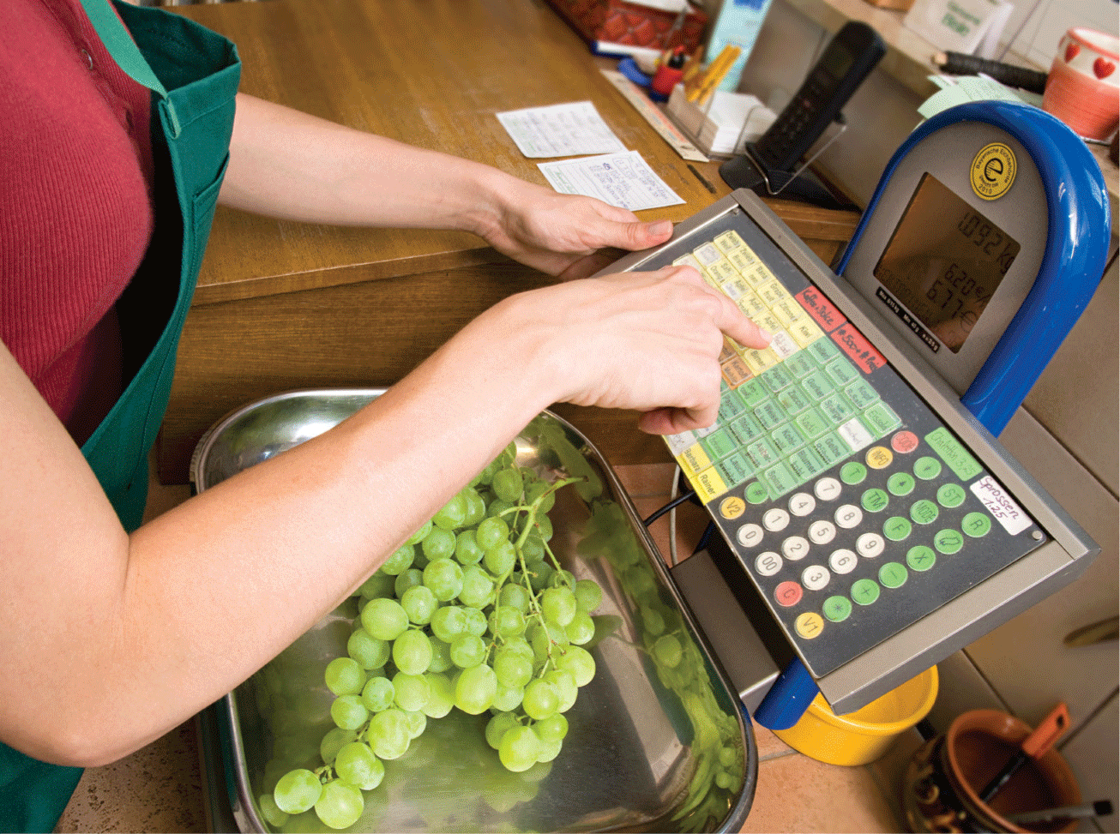
Card sorting techniques (3 of 5)
Where the results from a large number of people are available, various mathematical grouping techniques can be used.
Card sorting can be conducted face to face or using an on-line tool.
Hudson (2012) gives the example of a supermarket checkout vegetable pricing machine
If a customer has bought some onions, which category should they select?
How about if they have some courgettes, broccoli or aubergines?
If customers have to spend a long time searching for the right category (and any casual observation of supermarket checkouts suggests they do), queues will build up and people will get dissatisfied and go elsewhere next time they want to shop.
Source: Henglein and Streets/cultura/Corbis
Notes:
Figure 7.7 Supermarket vegetable weighing machine

Slide 64
Card sorting techniques (4 of 5)
As a method of understanding, card sorting can be a very effective method of gaining insight into how people think about things and classify them.
There are two types of card sort:
An open card sort starts with blank cards and participants are asked to write down the objects or actions they think are important in some domain. These are then gathered together into categories.
A closed card sort starts with predefined categories and asks participants to place objects into the categories.
As with most methods for understanding, it is likely that the analyst will move between these different types depending on the questions being addressed.
In the question of understanding what problems people are having using the checkout display, you would use a closed card sort because you already have the categories (the pictures on the display).
If you are trying to understand what categories different people would choose for vegetables, give them a list of vegetables and ask them how they would like to group them.
Hudson did this with 26 participants and got the results shown in Figure 7.8.

Slide 65
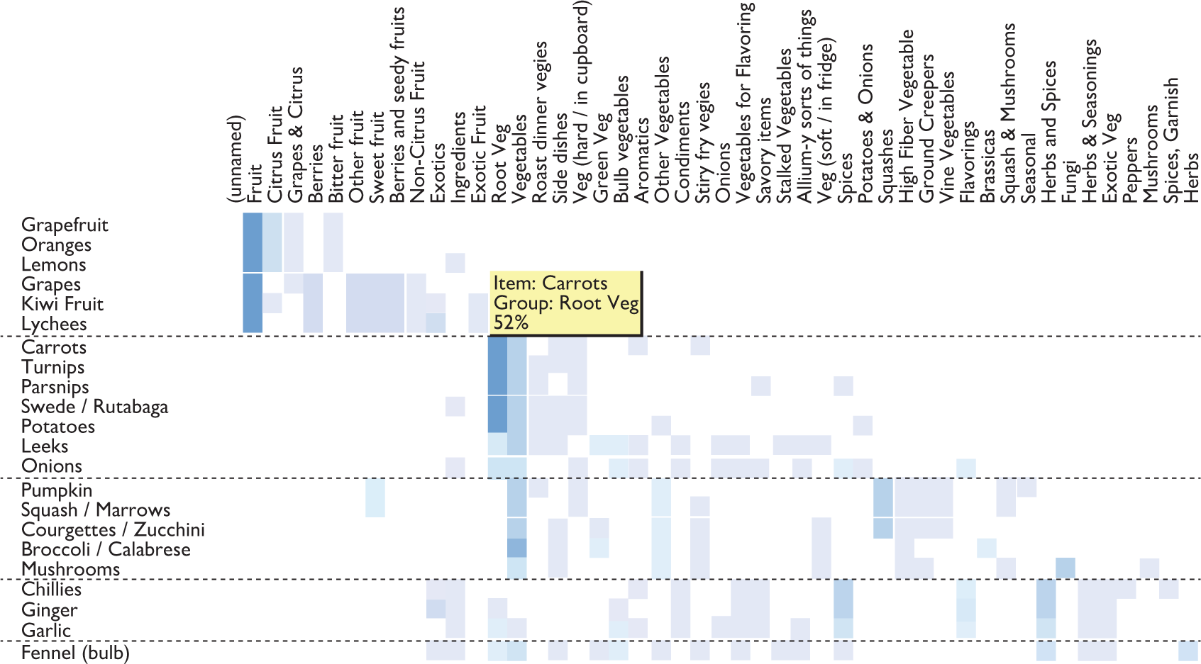
Figure 7.8 Results of card sorting exercise
Source: www.interaction-design.org/images/encyclopedia/cardsorting/groups chart 26 participants.jpg

Slide 66
Card sorting techniques (5 of 5)
You can also look at all the pairs of items that different people put in the same category and once again look for agreement or disagreement across different people.
Different classifications may suggest that there are distinct types of user who may need different classifications.
A cluster analysis such as this can be used to produce a dendrogram which shows the hierarchical clustering of objects (or actions).
Representations such as these can then be used in a reverse card sorting (or tree sorting) method to see how the hierarchy is traversed for different tasks.

Slide 67
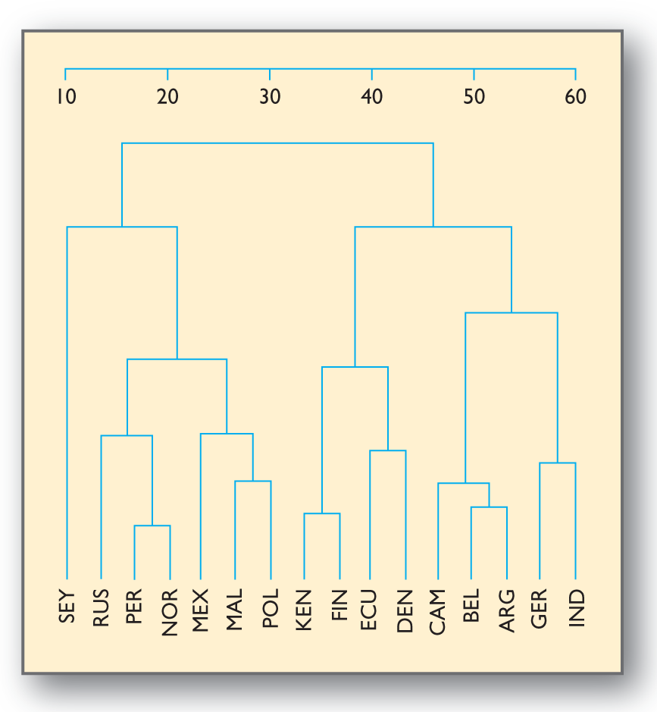
Figure 7.9
Dendogram

Slide 68
Card sorting techniques: Affinity diagrams (1 of 2)
Analysts really need to practice card sorting to understand the type of insight it can provide and when best to use the technique.
A hard part of this is knowing what to sort, which objects or actions to include and when in the overall understanding process the technique will be most helpful.
The affinity diagram, an important part of the contextual design approach (Holzblatt and Beyer, 2015), is essentially a card sorting technique used to bridge the immersive process of contextual inquiry and the creative process of ideation.
In this technique, short statements derived from the stories that users told when being interviewed are written on to sticky notes.
The design team then spend considerable time (Holzblatt and Byer 2015 suggest 2 or 3 days) grouping the notes together, looking to have 4–5 notes grouped into single issues.
Each group represents an issue.

Slide 69
Card sorting techniques: Affinity diagrams (2 of 2)
The groups emerge from the data and they are not pre-defined. The issue is then labeled and issues are grouped into bigger issues that in their turn are grouped into themes.
Holzblatt and Beyer (2015) suggest that if the process is done right, then a designer can read through the structure as if it were a story, reading down the themes to the detail of the actions that were obtained through the interviews.
They give an example of an app to support people with the activities of going on holiday together.
One of the big issues is ‘planning a trip together’.
This is broken down into the statements ‘We share the job of researching where to go’, ‘We plan the trip as a group’ and ‘I take responsibility for booking all or part of the trip’.
Actual user stories that support what are essentially conceptual scenarios are included at the bottom level of the affinity diagram.

Slide 70
Semantic understanding
The dendrogram representation in Figure 7.9 is also used in the repertory grid technique (RepGrid), which is based on the work of psychologist George Kelly (Kelly, 1955).
In this method, participants are asked to describe the concepts that they think characterize some topic.
For example, you might be investigating the qualities of personal devices and ask people to give adjectives (the constructs) that describe what they like about their mobile phone and other personal items (the elements).
These descriptive qualities are then used to provide ratings of the constructs.
For example, a mobile phone could be rated as heavy versus light, slim versus fat, comfortable versus uncomfortable and so on.
This type of analysis is also related to the semantic differential (Section 7.4) and to other techniques that focus on the measurement of meaning (Osgood et al., 1957).

Slide 71
Working with groups
An alternative to asking individuals or stimulating individuals to provide information is to work with groups of people.
The most common example of this is the focus group.
Here a group of people are posed questions by facilitators and encouraged to react to each other’s comments.
If they are part of a group, people can be asked to describe how they cooperate to manage activities.
Members of the group can stimulate each other’s memories and discussion may flow more naturally than in the single-person interview.

Slide 72
Focus groups (1 of 2)
Focus groups can be enhanced by the use of scenarios, prototypes and other stimuli.
For example, we have used a robotic pet as a stimulus for talking about companionship with groups of older people.
We have also used printed scenarios and screenshots of a mock-up automatic teller machine (ATM) to generate requirements for personalized ATM services and maps and visitor guides to generate requirements for a mobile guide application.
However, group discussion may inhibit comment about sensitive issues, where people may be reluctant to share their opinions.

Slide 73
Focus groups (2 of 2)
Many techniques have been developed to support focus groups.
One such example is CARD (Collaborative Analysis of Requirements and Design, Tudor et al., 1993; Muller, 2001).
Used by Microsoft and Lotus amongst others, CARD uses physical playing cards with which a group can lay out, modify and discuss the flow of an activity.
In the analysis phase, each pre-formatted card contains people’s accounts of what is done and why for an individual component of the activity.
Requirements on innovations in human practices or technologies can then be discussed around the cards. CARD is also intended to support design and evaluation.

Slide 74
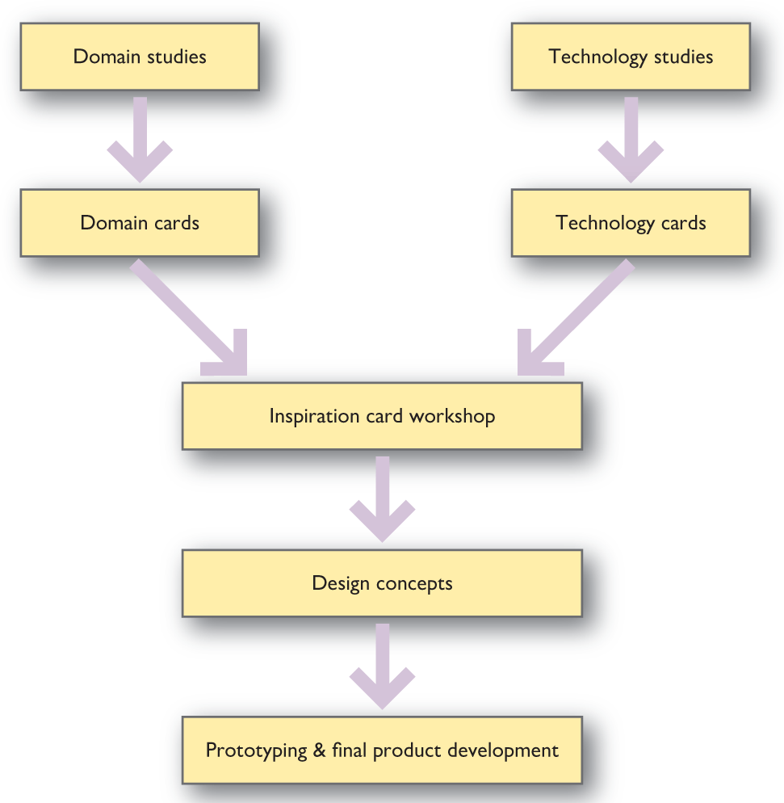
Figure 7.10
Inspiration Card Workshop

Slide 75
Inspiration card workshops
Halskov and Dalsgaard (2006) use a method called Inspiration card workshop.
Here physical cards (postcard sized) are used to stimulate group discussions about requirements and design.
There are cards to focus on domain issues and cards that focus on technology issues.
The cards are combined onto posters that can then be viewed by other groups (Figure).
In this way, key issues are raised and made available for discussion.
The authors argue that this is an important part of co-design, or co-creation, where designers and domain experts (future users) work together to generate requirements, rather than a designer trying to elicit requirements.
Other methods for group working include the Future Workshop (Jungk and Mullert, 1987) and a number of methods by Edward de Bono (De Bono, 1993).

Slide 76
IDEO method cards
This is a collection of 51 cards representing different ways that design teams can understand the people they are designing for.
The cards can be used by researchers, designers, engineers and mixed groups to think about design issues and generate debate.
The cards are classified as four suits – Ask, Watch, Learn and Try – that describe various types of activity.

Slide 77
Brainstorming (1 of 2)
Another important group activity is brainstorming.
Once again there is a wealth of good advice from management consultants and system designers about how to organize and structure brainstorming sessions.
Brainstorming sessions should be fun to participate in, but to achieve this, they require an experienced facilitator.
They also require some stimuli, whether as pictures, text or video, to get the ideas flowing.
Participants will need some way of recording their thoughts and ideas; a whiteboard, flip chart, paper and coloured pens.
Post-it Notes in different colours can be used to capture ideas.
This can be useful if the brainstorming session is followed by an affinity analysis where ideas are grouped together using different criteria.

Slide 78
Brainstorming (2 of 2)
An important point about brainstorming is not to dismiss ideas too soon.
The sessions should begin with an ‘anything goes’ approach.
Generate plenty of ideas.
These can then be filtered in a part of the session that tries to look at the feasibility of the ideas and their practical impact.
A good technique for helping brainstorming sessions is to get different members of the group to adopt different roles – the ideas generator, the critic, the sceptic, the pragmatic, the documenter and so on.
Robertson and Roberton (2012) provide plenty of good advice on organizing and structuring brainstorming sessions.

Slide 79
Fieldwork: Observing activities in situ
Observing people’s activities as they happen is another excellent method of understanding and requirements generation.
Interviews and questionnaires provide one side of the story but it is difficult for people to describe all the details of the relevant aspect of everyday life or work.
Sometimes this is because the activity is intrinsically difficult to describe in words – many manual procedures fall into this category (e.g. try describing how to ride a bicycle) – or because it requires complex and subtle cooperation with other people or events.
In other cases, an interviewee may describe the ‘official’ procedure rather than how something is actually done in practice.
People might be embarrassed to admit to some difficulty they are having or may just tell the designer something to get rid of them.

Slide 80
Observation (1 of 3)
Data from observation helps get round these problems.
In its simplest form, the designer can simply ask ‘Can you show me how you do that’ ? during an interview.
More complex or larger activities will require someone to spend some time on site observing as unobtrusively as possible.
This is best done after some initial interviewing, so you have some idea what it is you are looking at.
In many settings, everyone at the scene must be informed of what is happening and grant their permission in advance, even though they may not be your main focus.
In more public settings (e.g. building foyers, streets and railway stations), observations may be undertaken without the permission of those being observed but you should normally get the permission of the owners of the setting.

Slide 81
Observation (2 of 3)
Ideally, you need to see a range of variations on the normal activity and situations where things go wrong but this may not be possible in many situations.
Here the important point is to identify what you have not observed so you do not over-generalize from your data.
If you are lucky enough to be able to choose what you observe, then, just as with interviews, the time to stop is when no new information appears.
As in interviews, notes should be taken and video recording is very useful, particularly for sharing the observation with other design team members.

Slide 82
Observation (3 of 3)
Of course, observation is not without its difficulties.
Being unobtrusive is a skill of its own and your very presence will naturally tend to make people self-conscious and may alter their behavior (something known as the Hawthorne Effect, see Chapter 24).
With time, this effect will decrease.
It is much less of a problem where the activity you are observing absorbs all the participants’ attention or if you can find a task to carry out which does not interfere with your data collection.
It is also hard to observe effectively where the activity is simply one of the people processing data at computers with little or no interaction with other people or artefacts.
Here it would be more productive to ask people to demonstrate aspects of interest rather than waiting for them to occur in real time.
There are also ethical issues associated with observing people; permissions need to be obtained and anonymity of who said and did what should be ensured.

Slide 83
Ethical issues (1 of 2)
Most universities and research institutes will have a guide to the ethical issues involved when undertaking any form of study involving humans and this should be consulted before any studies are undertaken. The research councils for Canada, for example, organize their advice around three key features of ethical research that contribute to the overriding principles of Respect for Human Dignity. This document says….

Slide 84
Ethical issues (2 of 2)
‘The welfare of a person is the quality of that person’s experience of life in all its aspects. Welfare consists of the impact on individuals of factors such as their physical, mental and spiritual health, as well as their physical, economic and social circumstances. Thus, determinants of welfare can include housing, employment, security, family life, community membership and social participation, amongst other aspects of life. Other contributing factors to welfare are privacy and the control of information about the person and the treatment of human biological materials according to the free, informed and ongoing consent of the person who was the source of the information or materials’ (p. 9).
‘Justice refers to the obligation to treat people fairly and equitably. Fairness entails treating all people with equal respect and concern. Equity requires distributing the benefits and burdens of research participation in such a way that no segment of the population is unduly burdened by the harms of research or denied the benefits of the knowledge generated from it. Treating people fairly and equitably does not always mean treating people in the same way. Differences in treatment or distribution are justified when failures to take differences into account may result in the creation or reinforcement of inequities. One important difference that must be considered for fairness and equity is vulnerability. Vulnerability is often caused by limited capacity, or limited access to social goods, such as rights, opportunities and power’ (p. 10).

Slide 85
Design ethnography (1 of 5)
In the early twentieth century, pioneering ethnographic anthropologists endeavoured to understand an unfamiliar way of life through what has become known as ‘participant observation’ – learning about language, activities and culture through spending months or years living in the community under study.
The anthropologists talked to people, observed day-to-day life in detail and collected not just physical artefacts but stories, myths and so on.
Eventually, the resulting personal experience and field data were analysed and recorded as an ethnography.
Sociologists, notably those from the University of Chicago in the 1930s, employed similar techniques in the study of societies and groups closer to home.
In both domains, the basic approach continues to be used, including the core principle that the ethnographer should not interpose his or her own theoretical or cultural frameworks or expectations between the field data and the resulting ethnography.

Slide 86
Ethnomethodology
Following the work of Suchman (1987), most ethnography for technology design adopts a particular flavour of sociology termed ‘ethnomethodology’.
In short, ethnomethodologists hold that social rules and norms, and practices are not imposed externally on everyday life but that social order is continuously and dynamically constructed from the interactions of individuals.
As a corollary of this, it is philosophically unsound to generalize beyond the setting where the ethnomethodological ethnography has been undertaken, or to analyse the findings from a theoretical standpoint.

Slide 87
Design ethnography (2 of 5)
Ethnographic work in human-centred design projects is not always the preserve of specialist ‘ethnographers’.
As the approach has gained popularity, technologists and HCI practitioners frequently ‘do some ethnography’ for themselves.
Their sometimes casual adoption of the techniques has attracted some adverse comment from those trained in the field (Forsythe, 1999), and more cautious practitioners often refer to their work as ‘ethnographically informed’.

Slide 88
Design ethnography (3 of 5)
Design ethnography is a growing area of research and activity in UX design.
It recognizes the difference between undertaking ethnographies from an anthropologist’s perspective (where natural understanding is central) and the ethnographies practised by designers (where the aim is to inform design).
Specialist degrees are now offered that present the theory and practice of design ethnography.
The objectives for the design ethnographer are very much determined by those of the design project in hand.
They often focus on elucidating the role and high-level requirements for a proposed new technology through a deep understanding of work in practice.

Slide 89
Design ethnography (4 of 5)
Dourish and Bell (2014) provide a compelling description of ethnographic and cultural anthropology in the context of the development of ubiquitous computing environments.
They map out the terrain of contemporary computing exploring rich issues such as infrastructure, mobility, privacy, and domesticity.
In other projects, the ethnographer’s added value to the process of understanding is in the definition of usage stories and scenarios, the identification of practical issues for implementation and as a focus for a higher degree of stakeholder involvement.
The discussion in the final chapter of Heath and Luff (2000) is a particularly clear account of moving from ethnography to requirements using video-based studies of medical consultations.

Slide 90
Design ethnography (5 of 5)
Design ethnography requires a sensitivity on the part of the designer and a willingness to open up to the issues that people in a particular setting are concerned about.
Design ethnographers focus on activities, rules and procedures, the physical layout of place where the activities take place and the use of artifacts in the work or leisure activities.
Of course, the internet and mobile devices will often be a fundamental part of any activity and design ethnographers need to be particularly sensitive to the way these artifacts and the social networks that they enable contribute to peoples’ activities.
A set of guiding questions can be useful.

Slide 91
Rogers and Bellotti’s ‘reflective framework’ for ethnographic studies
Why is an observation about a work practice or other activity striking?
What are the pros and cons of the existing ways technologies are used in the setting?
How have ‘workarounds’ evolved and how effective are they?
Why do certain old-fashioned practices, using seemingly antiquated technologies, persist, despite there being available more advanced technologies in the setting?
Envisioning future settings what would be gained and lost through changing current ways of working or carrying out an activity by introducing new kinds of technological support?
What might be the knock-on effects (contingencies arising) for other practices and activities through introducing new technologies?
How might other settings be enhanced and disrupted through deploying the same kinds of future technologies?

Slide 92
Other ethnographies
Design ethnography can also be undertaken on-line as opposed to just face-to-face.
Here researchers may monitor social networks, join on-line communities, follow discussion groups, watch relevant YouTube videos and search out other on-line contributions to the domain of study.
The term ‘netography’ has been used to describe on-line ethnographic research (Kozinets, 2010) where the advice is to follow good ethical and anthropological practice of being involved in the community rather than being a distant observer.
Autoethnography (Ellis, Adams and Bochner, 2011) is an approach to understanding based on ethnographic study of one’s self.
The key to (relatively) economical ethnographic work is to recognize when enough data has been collected.
One indication of ‘enough’ may be that no new details are emerging.
Another is being able to identify what has not been observed but will not happen within the span of the current work.

Slide 93
Analysing data
Of course, time is required not just to acquire the data but to analyse it.
Video is intensely time-consuming to analyse – at least three times the length of the raw sequence and frequently more, depending on the level of detail required.
The process can be streamlined by having an observer take notes of significant points in the ‘live’ action; these notes then act as pointers into the video recording.
Software tools such as Atlas.ti and Nvivo help in analysing pages of text notes (not just of observations but also transcripts of interviews and group sessions) and, in some cases, audio and video data.
For large projects, material can be organized into a multimedia database or web-based repository.

Slide 94
Communicating ethnographic results (1 of 2)
Communicating ethnographic results can be challenging.
One approach is to encapsulate the findings in ‘vignettes’ – short descriptions of typical scenes.
A vignette is very similar to a scenario but less structured than the format we have proposed – perhaps more like the text of a scene in a play script, complete with stage directions.
The vignettes are usually accompanied by a transcript of the accompanying dialogue.
Vignettes are often supplemented by video extracts and sample artefacts.
Another possibility is for the ethnographer to act as an evaluator of early concepts or prototype designs, before the requirements are finalized and while the design is too immature to benefit from user feedback.

Slide 95
Communicating ethnographic results (2 of 2)
A still closer link between workplace studies and system design has been attempted (Viller and Sommerville, 2000).
This takes the output from the study and expresses its findings in the UML notation (UML is the Unified Modeling Language).
By contrast, Heath and Luff (2000) and Dourish (2001) and Dourish and Bell (2011) argue that the purpose of workplace ethnography is to construct a reservoir of experience that allows designers to uncover how people make sense of technology in use and so to design tools which support the improvised, situated and continually reconstructed nature of real-world activity.

Slide 96
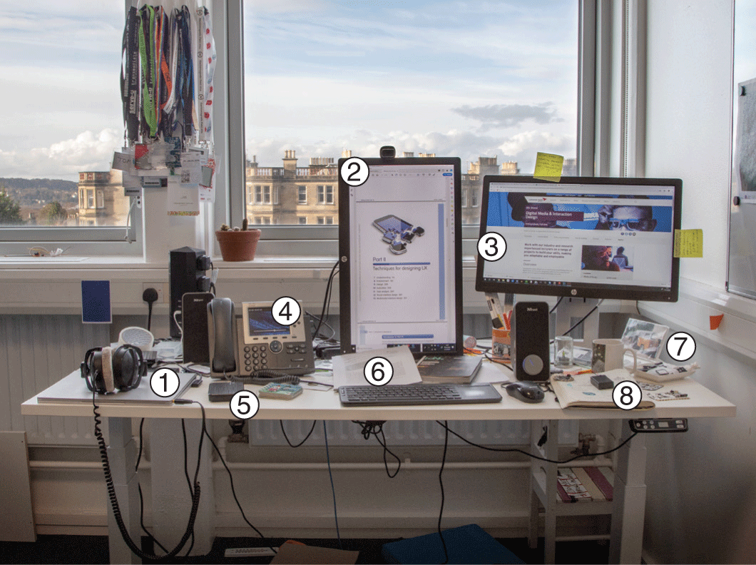
Artefact collection and desk work
Data from interviews, questionnaires and observation will have identified a range of artefacts in the form of things that support an activity.
It is often possible to supplement this by collecting artefacts such as documents, forms or spreadsheets in office settings or to video or photograph items that cannot be removed.
Systems, apps and services that are somehow similar to the domain under investigation should also be studied.
Figure 7.11 shows the sort of photograph which might be taken and annotated to capture the range of information artefacts used in everyday work in an academic’s office. These include the following:
Laptop used for file archiving, calendar, document production, e-mail and internet
Paper notebook – notes of ad hoc meetings also holds currently important papers
Printouts of journal articles
CD – current backup
(Under mug) miscellaneous documents
Sticky notes with ‘to do’ items, important phone numbers and IP address of laptop
Telephone – internal and external calls
Desktop PC – older file archive and connection to network backup used for email/internet if laptop connection fails.
Sometimes, it can be helpful to track a document through a system, noting everyone who interacts with it and how the document is amended at each stage – a technique sometimes known as a ‘tracer study’.
Source: Tom Flint
Notes:
Figure 7.11 Artefacts on and around an office desk

Slide 97
Example
In a study of a health benefits claim processing system, for example, we collected copies of blank claim forms, standard letters sent to claimants, inter-office memos and the public information leaflet about the benefit.
By chance, we also found a copy of an article that provided a valuable insight into health professionals’ views in a local newsletter.
These artefacts helped ensure that we had a complete understanding not only of the data processed through the system but also of their relative importance and significance (what information requests are in bold type, what details have to be verified by a medical practitioner or pharmacist, etc.) and how annotations on the original documents were used as notes of progress through the system.
In another medical example, this time in a hospital, Symon et al. (1996) show how the very appearance and style of a doctor’s handwritten notes on patients’ records revealed valuable background details to other staff, such as whether the consultation had been carried out in a hurry.
All such informal features of the way artefacts are used in practice will make demands on the design of supporting technology.

Slide 98
Other desk work
Understanding activities does not just involve working directly with the people who are doing the activity now or who will be in the future.
The designer will need to do plenty of ‘desk work’ as well.
This may include records of requests for help or user support and records of bugs reported and change requests often reveal gaps in functionality or presentation.
Other desk work involves reading procedure manuals and other material about the organization.
It involves studying existing software systems to see how they work and what data is kept.
Desk work involves collecting and analysing any documents that exist and documenting the movement of documents and the structure of objects such as filing cabinets and ledger books.

Slide 99
Looking at similar systems
Looking at similar products, services or apps is another way of getting ideas.
A market analysis looks at similar products that have been produced or services that are provided.
This can be useful because the designer can see the product or service being used in situ and can consider the design solutions that others have proposed.
This might highlight good and poor solutions for particular design problems.
Looking at similar activities complements such an analysis.
An activity might be in quite a different setting from the one under scrutiny but might have a similar structure.
For example, looking at a video hire shop might provide inspiration for a car hire application or looking at an automatic coffee machine might help in understanding an ATM activity.

Slide 100
Challenge 7.6
What artefacts might you collect or photograph relating to people’s use of communications technologies in the home? (Hint: think about non-electronic media as well.)

Slide 101
Data analysis (1 of 2)
Of course, gathering data on its own is not sufficient to gain an understanding of the domain, any difficulties people are experiencing and the requirements for any new service or system.
The data needs to be analysed, digested, synthesized and presented in a way that other designers and all the stakeholders can understand.
This involves designers immersing themselves in the data and taking time to explore the relationships between the data.
A key distinction in methods of data analysis is between quantitative analysis and qualitative analysis.

Slide 102
Quantitative analysis
Quantitative analysis involves gathering countable measures of some criteria.
For example, a quantitative analysis of a questionnaire would focus on the number of people who answered the different questions in particular ways, or the percentage of the people who responded to the different questions.
A quantitative analysis might include looking at the average number of people in different categories, the mean or mode of a data set and the size of the standard deviation of the population from the mean.
Various statistical tests of the significance of the data that has been gathered can be performed in order to inform the analysis.
We cover the design of experiments and the analysis of statistics in Chapter 10.

Slide 103
Qualitative analysis
A qualitative analysis of data relies on the designer building an argument to support a view, making use of the data in a sensitive, user-focused way.
For example, following the process of interviewing a number of users, the designer will read over the transcripts and look for recurring themes or issues that people are talking about.
This might be backed up by observations that show for people having particular problems and following some desk work looking at similar products or services, the designer might point to some key issue that is currently badly covered by existing designs.
Data analysis is all about understanding themes and categories that are more abstract than the raw data.

Slide 104
Data analysis (2 of 2)
In Chapter 3, we presented a design method that used stories as the raw data and collected these together into conceptual scenarios.
This process of abstraction led to a better understanding of the domain.
Earlier in this chapter, we discussed gaining a semantic understanding by using semantic differentials to gather data about the key descriptors of some domain.
The scores on the detailed adjectives will be grouped together into larger concepts and themes to inform design.
Different methods will be used in different ways to collect different types of data at different stages in design, so it is likely that the designer will use a range of qualitative and quantitative methods during the understanding process.

Slide 105
Bricoleur
In this sense, the UX designer can be seen as a ‘bricoleur’.
A bricoleur is a designer who makes use of what is to hand in order to fashion some creative work.
A bricoleur engages in bricolage, improvising with different methods and materials in art, literature, architecture or design. In UX, bricolage is using a variety of methods for understanding that are pragmatic and appropriate in the current setting.

Slide 106
Triangulation
In order to be sure about the robustness of some data analysis, the UX designer should use some form of triangulation to verify findings.
Triangulation refers to the investigation of some phenomenon or some domain from at least two complementary positions.
This could be getting two different researchers to analyse some data aiming to ensure inter-rater reliability of results.
Data drawn from two or three different sources can be used to triangulate results.
They are stronger results if they can be found in different data sets, or using different data gathering processes.

Slide 107
Theoretical position
A further issue in data analysis is to consider the theoretical position that informs the analysis.
For example, grounded theory (Corbin and Strauss, 2014) is a qualitative method suitable for the analysis of the results of an ethnographic study, or an analysis of in-depth interviews.
Here, transcripts of video or audio are marked up with tags – metadata that puts the word or phrase into a category.
In the open coding approach, the researcher tags statements from the bottom up, grounded in the text, without concern (initially) as to where these concepts have come from.
Axial or thematic coding is concerned with developing themes from the data.
A common way of approaching this is to start off with a large number of low-level themes (maybe 30, or 50 in some domain) and then have a second pass through the data to see if any of the themes can be collected together into larger themes.
These larger themes then create the axes within which to undertake further analysis.
There is much discussion about grounded theory and the philosophical issues that surround it and ethnomethodological approaches to gathering and understanding data.
The original exposition (Glaser and Strauss, 1967) has led to much heated debate over the years.

Slide 108
More theory
Researchers and designers may use theoretical positions that are presented in Chapter 23 or Chapter 11 to drive their data collection or analysis.
For example, distributed cognition (Chapter 23) is an approach to understanding systems that recognize the importance of various artifacts and people coming together as a complex system necessary to achieve goals in some domain.
Models of the information flows and structures (such as ERMIA, Chapter 11) can be developed to represent the whole system.
Another view of human cognition focuses on how activities are decomposed into actions that in turn are broken down into operations.
The focus here is on how the system as a whole can achieve the objective of the system and on the use of artefacts to mediate actions.
We discuss activity theory in Chapter 23.

Slide 109
Humanistic UX
More recently, Jeffrey and Shaowen Bardzell have suggested an approach to understanding and design that comes from a humanistic tradition (Bardzell and Bardzell, 2014).
They use critical theory and other methods from literature and cultural studies to inform the data gathering and analysis for UX design.
Their focus is on critical analysis of the discourse uncovered through qualitative methods of interviews, observations and so on and on the intertextuality of different methods (similar to the ideas of triangulation).
Their design approach focuses on aesthetics of UX, on the poetics of UX and on the pragmatics of UX.

Slide 110
Summary
In this chapter, we have focused on some widely used techniques for understanding people and activities in context, so we can identify requirements on the design of new technologies.
However, there is no firm distinction between requirements, envisionment, design and evaluation, so many of the techniques described here could be used at various stages of the design process.
Design starts with researching and understanding the situation at hand, but in the course of achieving that understanding, designers iterate between the exploration of new concepts, envisioning ideas and the understanding and evaluation of ideas, designs and opinions.
Using the techniques described here should ensure that designers undertake a human-centred process.

Slide 111
Key points
Techniques for understanding people’s activities in context include interviews, observation and collecting samples of artefacts, complemented by background research away from the domain of interest.
Using more than one technique helps compensate for their individual limitations.
Requirements work must be documented for communication and use in design; one way of doing this is a requirements specification supported by illustrative materials, another is in developing a scenario corpus.
Understanding includes the analysis of data and this can be approached from a number of different perspectives, whether informed by one or more theories of cognition and action or whether the research takes an approach based on bricolage.

